Slide 1
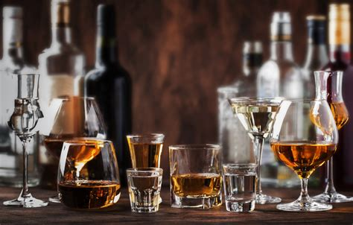
Alcohol Sales in Texas
Christopher Barraza
David James
Victoria Munoz
Jordan Tellez

Slide 2
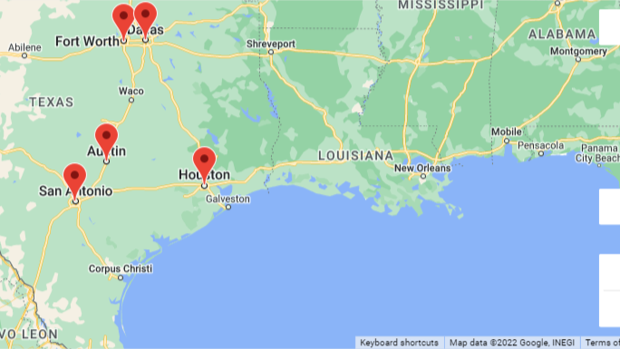

Slide 3
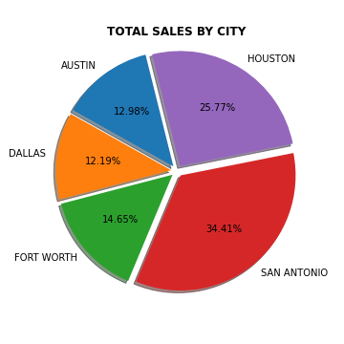
Sales By City

Slide 4
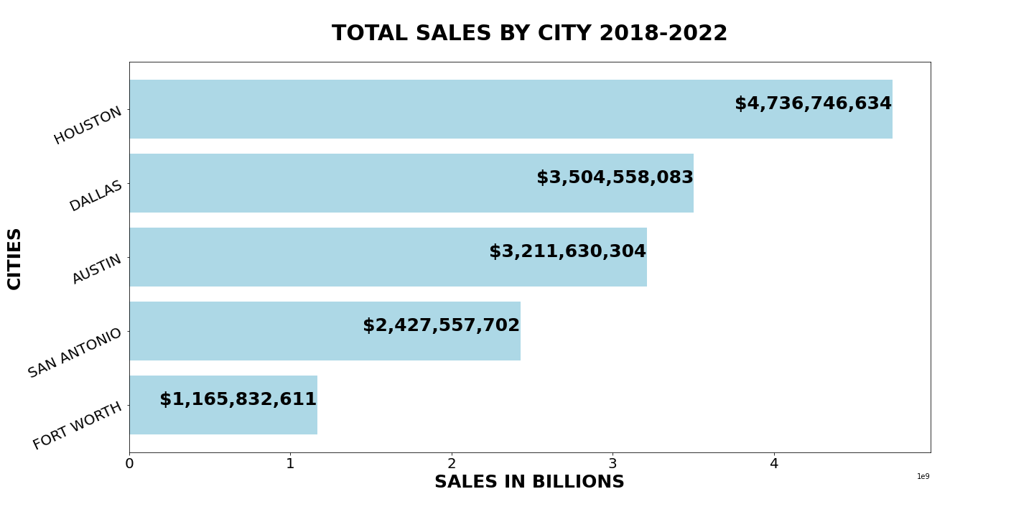
Sales By City

Slide 5
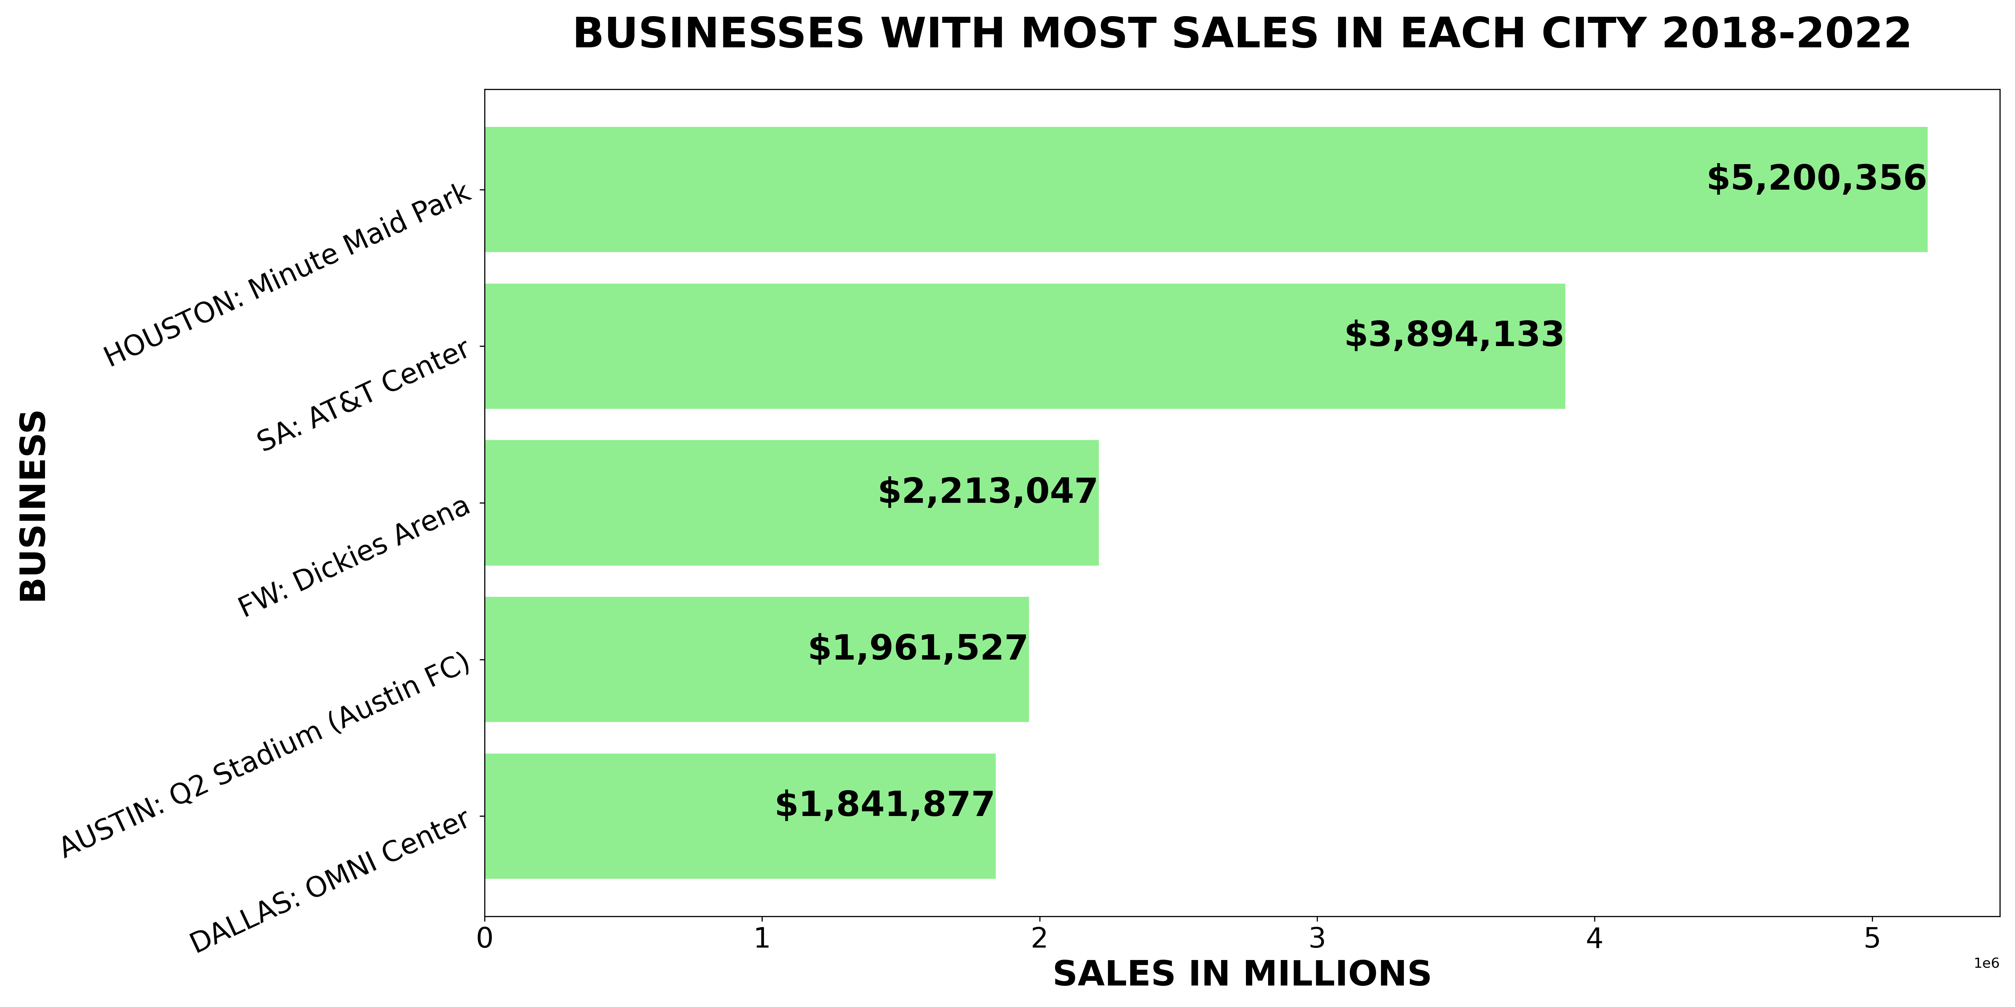
Max Sales Per Business By City

Slide 6
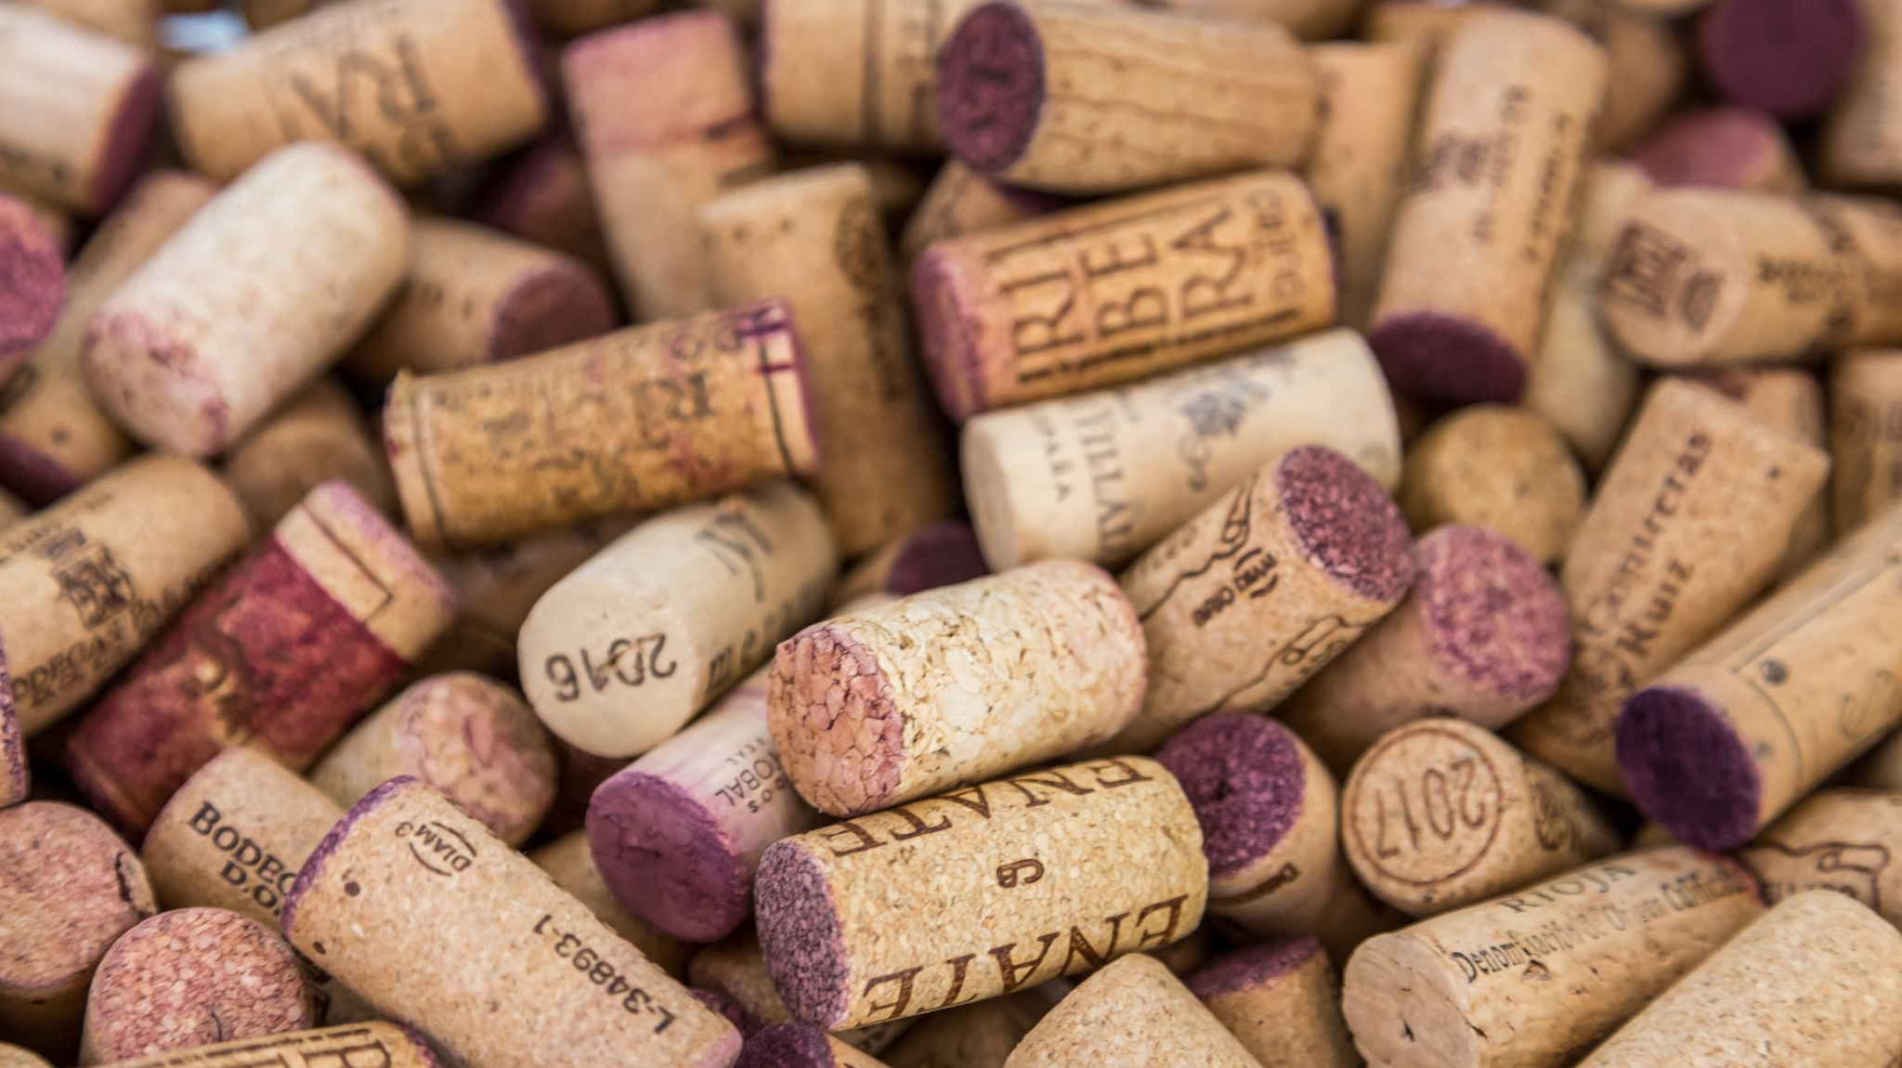
Wine Sales

Slide 7
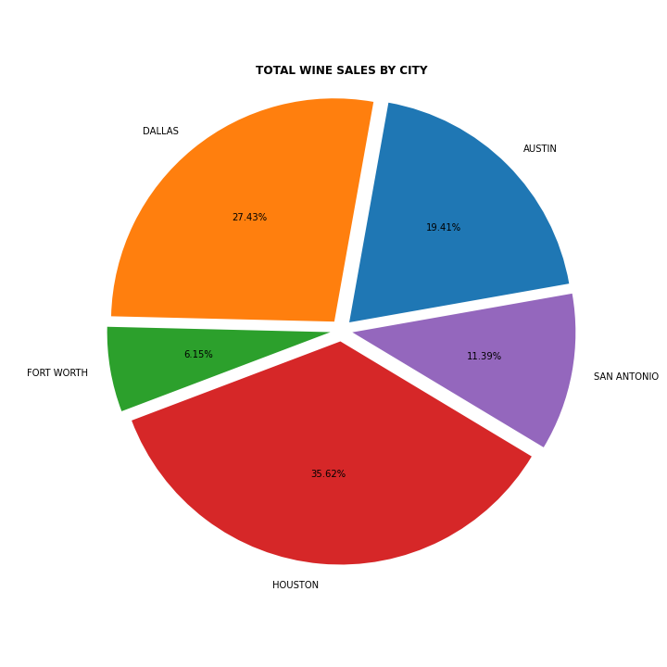
Wine Sales By City

Slide 8
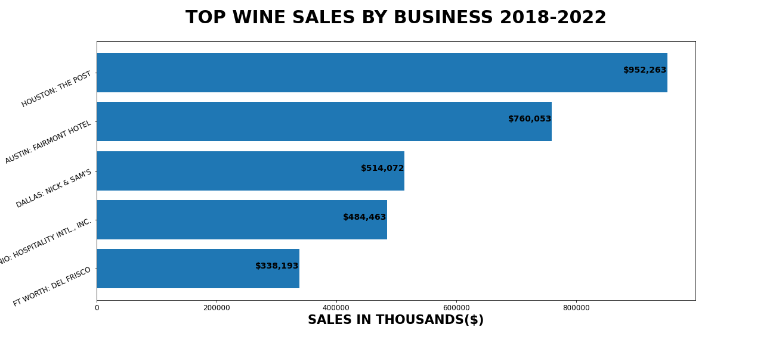
Wine Sales By Business

Slide 9
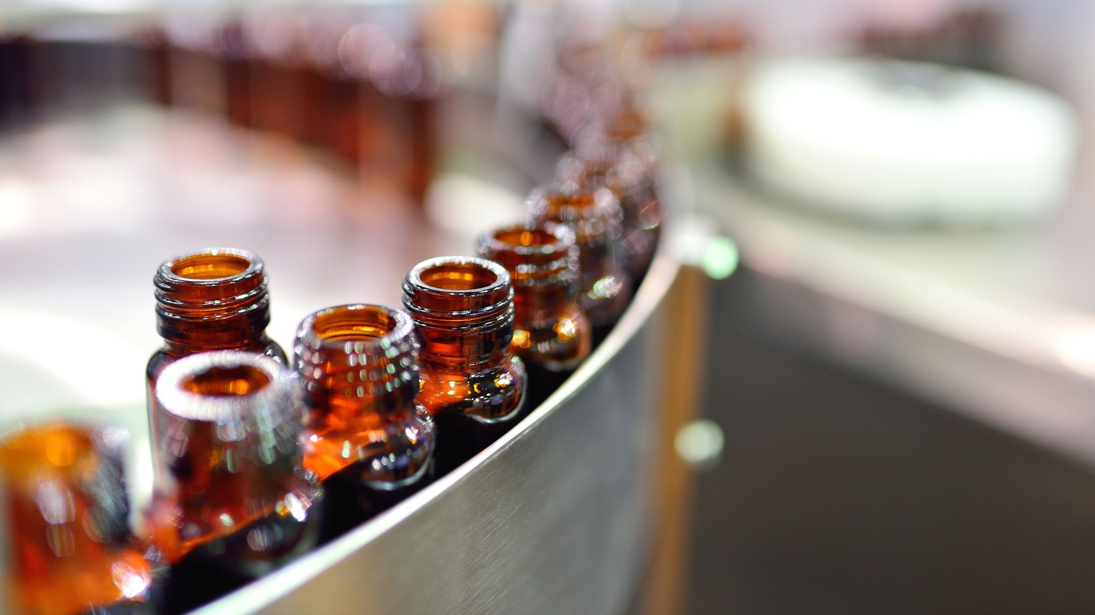
Beer Sales

Slide 10
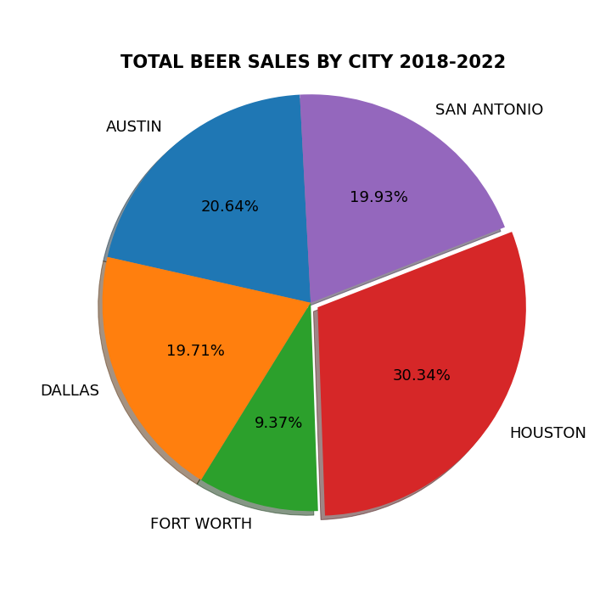
Beer Sales By City

Slide 11
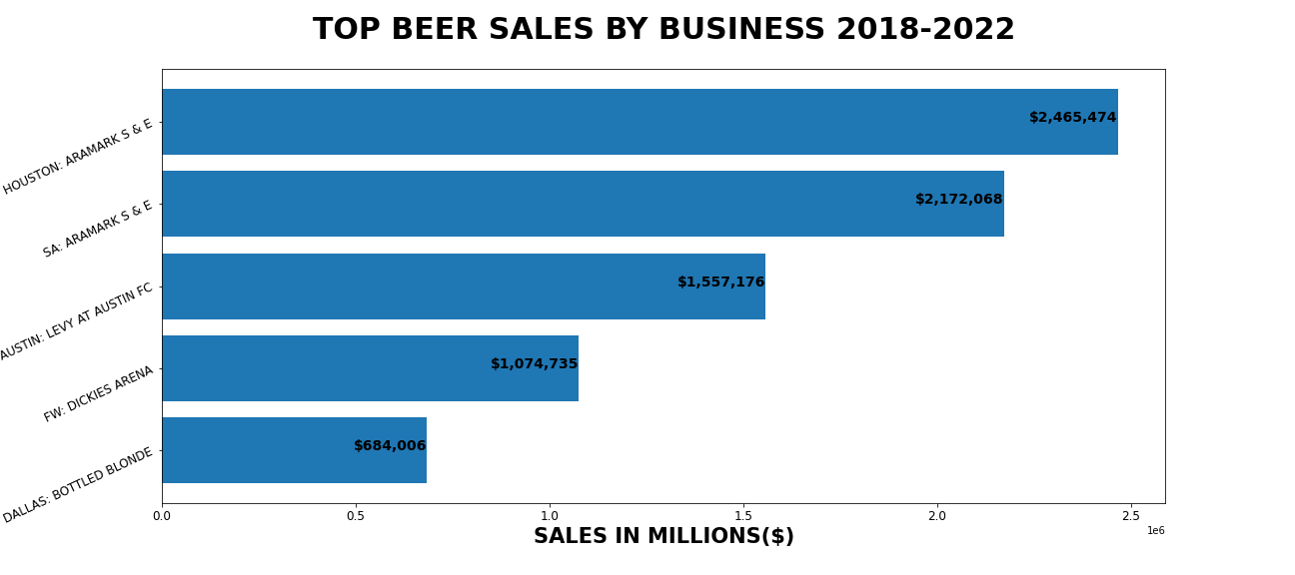
Beer Sales By Business

Slide 12
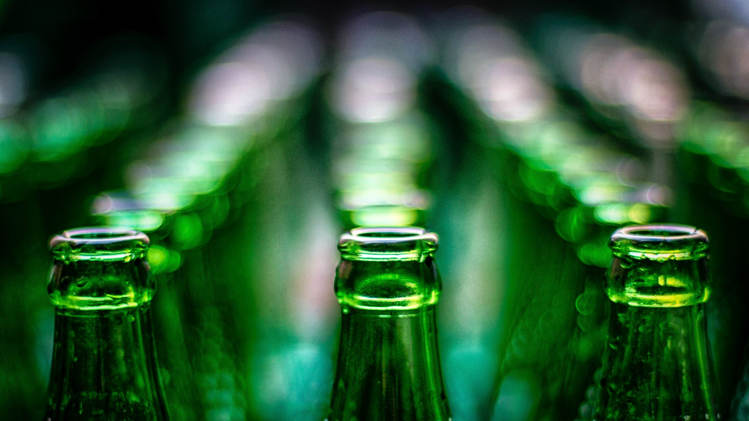
Liquor

Slide 13
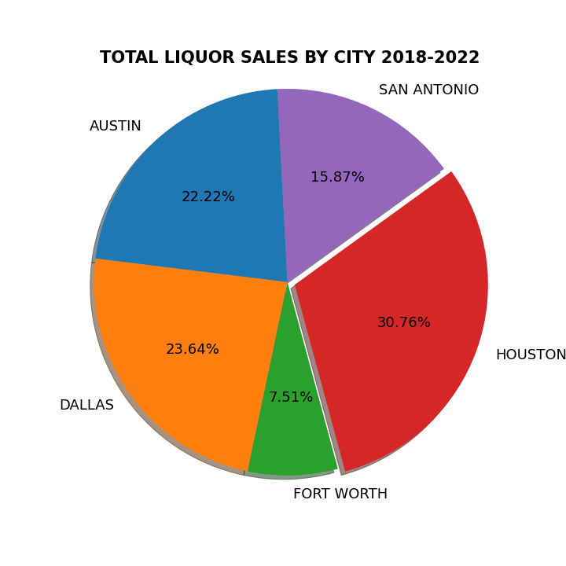
Liquor Sales By City

Slide 14
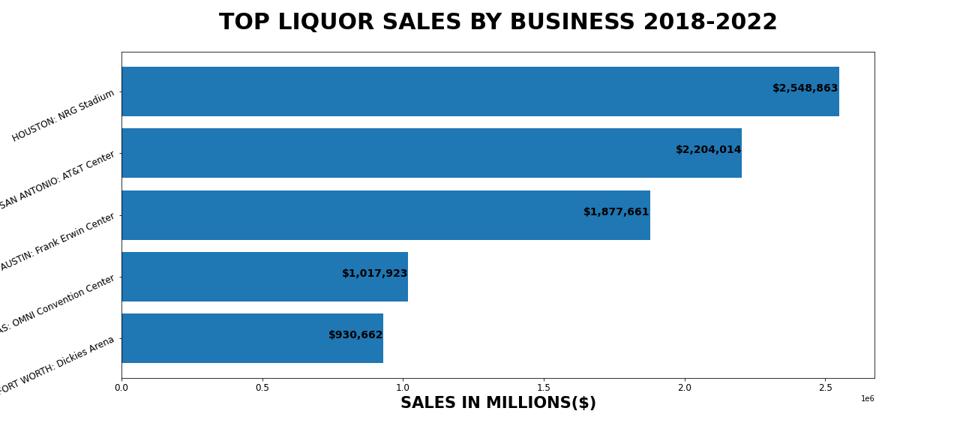
Liquor Sales By Business

